Slide 1
McKinsey 7S Framework
Name of course here

Slide 2
The Mckinsey 7S Model
STRUCTURE
STRATEGY
SYSTEMS
The McKinsey 7S Framework is a management model developed by business consultants Robert H. Waterman, Jr. and Tom Peters in the 1980s. This was a strategic vision for groups, to include businesses, business units, and teams.
SHARED
VALUES
SKILLS
STYLES
HARD ELEMENTS
SOFT ELEMENTS
Strategy
Structure
Systems
Shared Values
Skills
Style
Staff
STAFF

Slide 3
The McKinsey 7S Model
Systems
Skills
Staff
Strategy
Structure
Shared Value
Style
MCKINSEY 7-S
FRAMEWORK
ENSURES COMPANY IS ALIGNED TO ITS GOALS

Slide 4
Analyze impact of future organizational change
Enhancement of organizational effectiveness
ADVANTAGES
OF 7S MODEL
Comprehensive framework
Aligns organizational departments & processes
Links academic research with management practice
Implementation strategies

Slide 5
The 7 interdependent elements
Actions a company plans in response to change in its external environment
Formal and informal procedures that support the strategy and structure
Process used to develop managers and ways to introduce young recruits to the company
Guiding concept around which a business is built – must be simple, usually stated at abstract level
STRATEGY
STRUCTURE
SYSTEMS
STYLE
STAFF
SKILLS
SHARED VALUES
Basis of specialization and coordination influenced primarily by strategy, size, and diversity of organization
Organizational Culture: The dominant values, beliefs & norms which develop over time.
Management Style: More a matter of what managers do that what they say, how do company managers spend their time.
The distinctive competences – what the company does best

Slide 6
The 7 interdependent elements
Purpose of the business & the way the organization seeks to enhance its competitive advantage
Division of activities; integration and coordination mechanism
Formal procedures for measurement, reward and resource allocation
Hard Elements
STRATEGY
STRUCTURE
SYSTEMS
Soft Elements
Explicit or implicit fundamental beliefs, concepts and principles that underlie the culture of an organization
The organization’s core competencies and distinctive capabilities
Organization’s human, resources, demographic, educational and attitudinal characteristics
Typical behavior patterns of key groups, such as managers, and other professionals
SHARED VALUE
SKILLS
STAFF
STYLE

Slide 7
What should we do to solve the specific business problem?
What structure do we need to execute the strategy?
STRATEGY
STRUCTURE
SHARED VALUE
What are the specific skills that will help us? What skills do we need to develop?
What business system do we need to use or invent to execute the strategy?
SKILLS
Which of our principles help us? Why do we do what we do in the way we do it?
SYSTEMS
What leadership style and cultural qualities will help us to achieve a strategic objective?
How should we help our managers in their growth?
STYLE
STAFF

Slide 8
The McKinsey 7S Model
z
Systems
Style
Hard elements are feasible and easily identified
These elements are also easier to change than soft elements
They can be found in strategy statements, corporate plans, organization charts, and other business documents
Soft elements are harder and take longer to change
They are harder to describe, since capabilities, values, and elements of corporate culture are continually evolving
Determined by employees of the organization
Structure
Staff
HARD ELEMENTS
SHARED
VALUES
SOFT ELEMENTS
Strategy
Skills

Slide 9
Questions to ask (Hard Elements)
STRATEGY
STRUCTURE
SYSTEMS
What is our strategy?
How do we intend to achieve our objectives?
How do we deal with competitive pressure?
How are changes in customer demands dealt with?
How is strategy adjusted for environmental issues?
How is the company/team divided?
What is the hierarchy?
How do the various departments coordinate activities?
How do the team members organize and align themselves?
Is decision making and controlling centralized or decentralized? Is this as it should be, given what we're doing?
Where are the lines of communication? Explicit and implicit?
What are the main systems that run the organization? Consider financial and HR systems as well as communications and document storage.
Where are the controls and how are they monitored and evaluated?
What internal rules and processes does the team use to keep on track?

Slide 10
Questions to ask (Soft Elements)
What positions or specializations are represented within the team?
What positions need to be filled?
Are there gaps in required competencies?
What are the strongest skills represented within the company/team?
Are there any skills gaps?
What is the company/team known for doing well?
Do the current employees have the capability to do the job?
How are skills monitored and assessed?
How participative is the management/leadership style?
How effective is that leadership?
Do employees/team members tend to be competitive or cooperative?
Are there real teams functioning within the organization or are they just nominal groups?
What are the core values?
What is the corporate/team culture?
How strong are the values?
What are the fundamental values that the company was built on?
STAFF
SKILLS
STYLE
SHARED VALUE

Slide 11
STRATEGY
STYLE
What should we do to solve the specific business problem?
What leadership style and cultural qualities will help us to achieve a strategic objective?
STRUCTURE
HARD S
SHARED VALUES
SOFT S
STAFF
What structure do we need to execute the strategy?
Which of our principles help us? Why do we do what we do in the way we do it?
How should we help our managers in their growth?
SYSTEMS
SKILLS
What business system do we need to use or invent to execute the strategy?
What are the specific skills that will help us? What skills do we need to develop?

Slide 12
7S Analysis
Employee = Human Resource
How do we recruit?
Technique and know-how
What kind of technical know-how do we have?
STAFF
SKILLS
SHARED
VALUE
Strategy
What is an advantage?
HARD
ELEMENTS
STYLE
SOFT
ELEMENTS
Corporate Philosophy
Vision and objectives
STRATEGY
SYSTEMS
STRUCTURE
Corporate Culture
How do we think or act as a company
Organizational Structure
Department, team, etc.
The system within the company
How to communicate or report

Slide 13
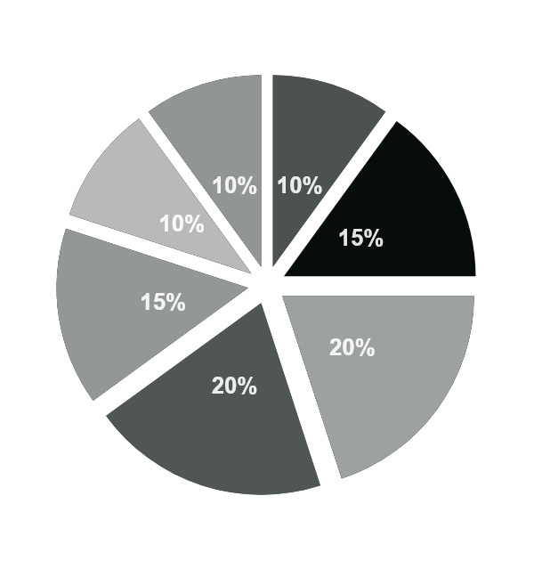
SHARED VALUES
STYLE
Which of our principles help us? Why do we do what we do in the way we do it?
What leadership style and cultural qualities will help us to achieve a strategic objective?
STRATEGY
What should we do to solve the specific business problem?
MCKINSEY 7S MODEL
STAFF
How should we help our managers in their growth?
STRUCTURE
What structure do we need to execute the strategy?
SKILLS
SYSTEMS
What are the specific skills that will help us? What skills do we need to develop?
What business system do we need to use or invent to execute the strategy?

Slide 14
McKinsey 7S Matrix
POSITIVE
NEUTRAL
NEGATIVE
Structure
Strategy
System
Shared Value
Staff
Style
Skills
Structure
Strategy
System
Shared Value
Staff
Style
Skills

Slide 15
McKinsey 7S Matrix
SKILLS
SHARED
VALUES
STYLE
STAFF
SYSTEMS
STRUCTURE
STRATEGY
Text Here
Text Here
Text Here
STRUCTURE
Text Here
Text Here
SYSTEMS
Text Here
Text Here
STAFF
Text Here
STYLE
Text Here
SHARED
VALUES

Slide 16
Case Study Example
SYSTEMS
STYLE
Management style and corporate culture, How staff is managed and the impacts this has on productivity
Procedures in place to achieve business outcomes (typically the daily activities)
Corporate hierarchy & critical business units, as well as key responsibilities for employees and teams
STRUCTURE
Norms, principles, and standards that are the ‘company guidelines’ that all staff members follow
STAFF
Recruitment, training and development needs
Plan to remain competitive. Strategy needs to clearly show what the key objectives and goals of the business are.
STRATEGY
SKILLS
Competencies and capabilities that can be leveraged to determine if the client has the skills needed to achieve future goals

